Slide 1

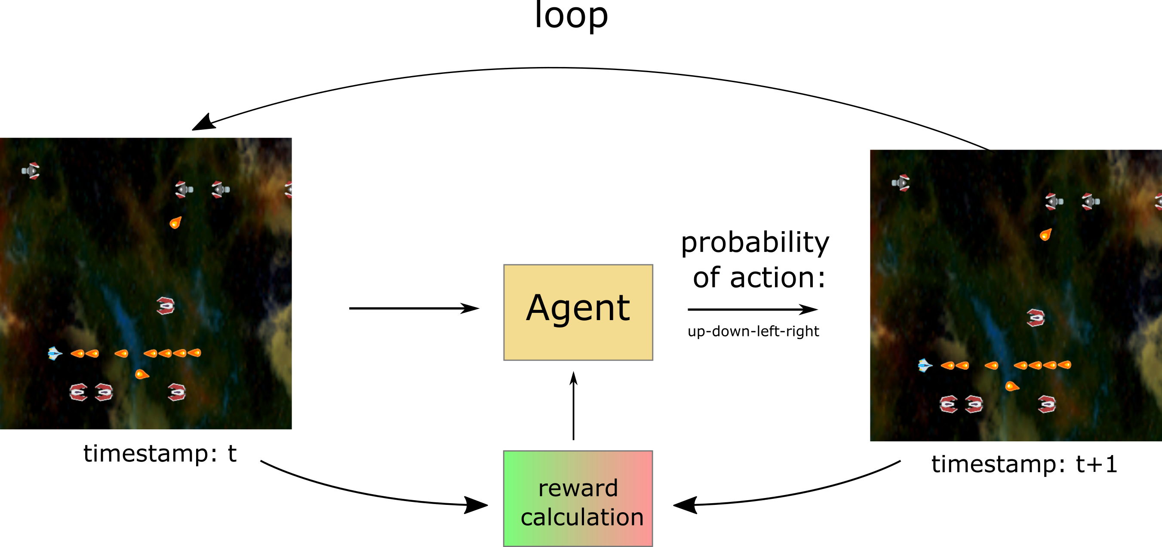
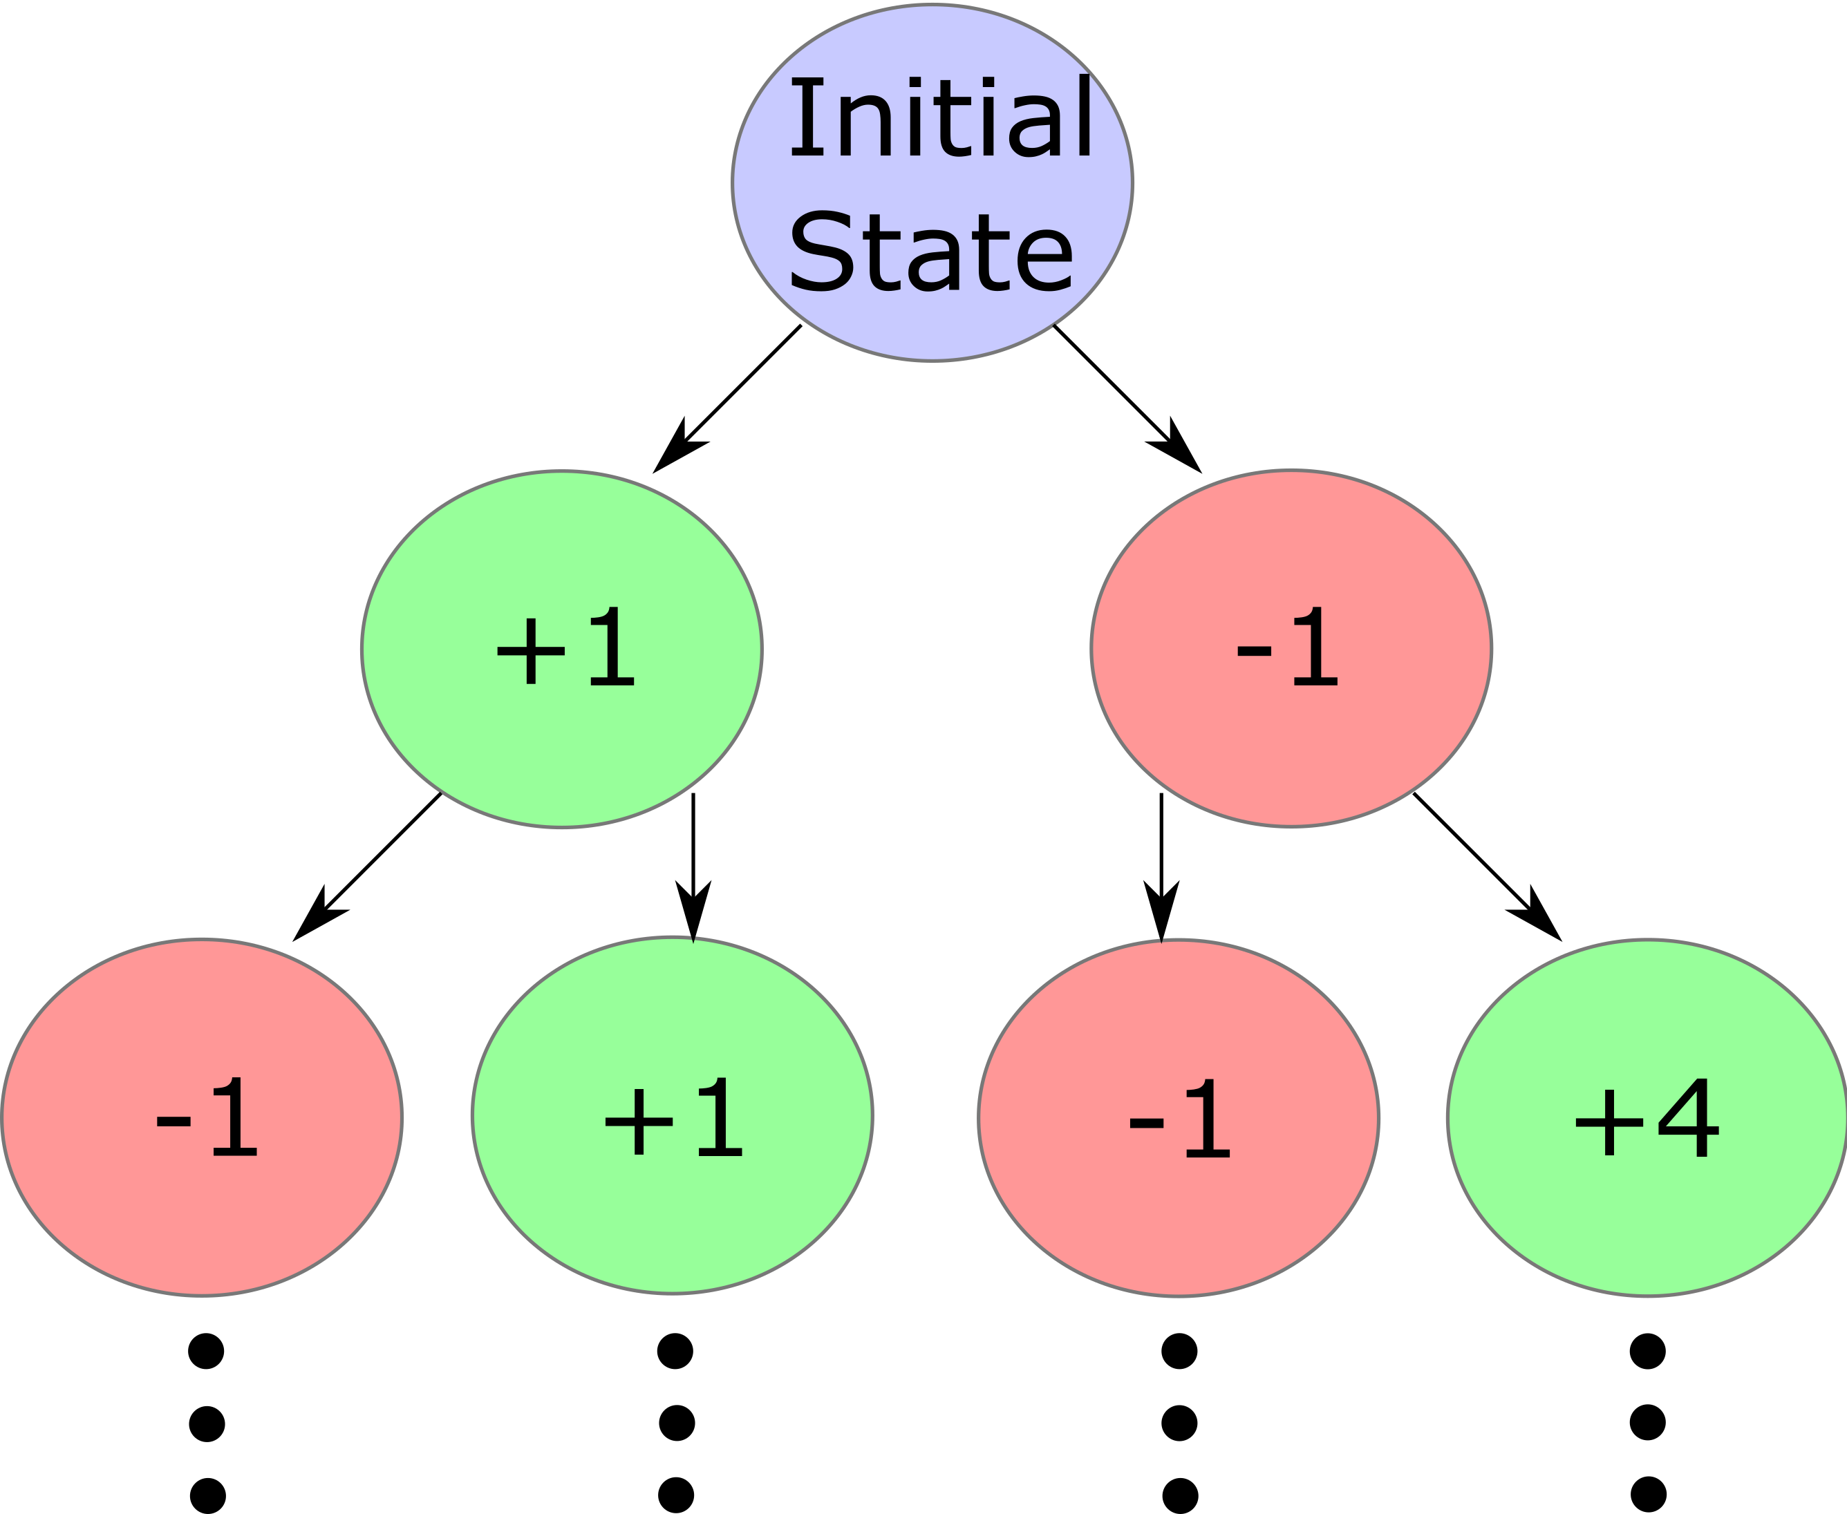
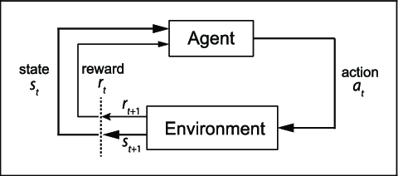
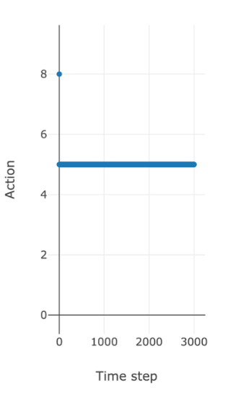
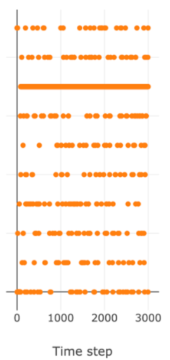
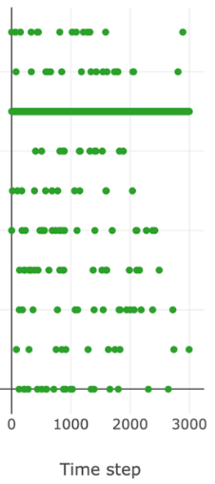
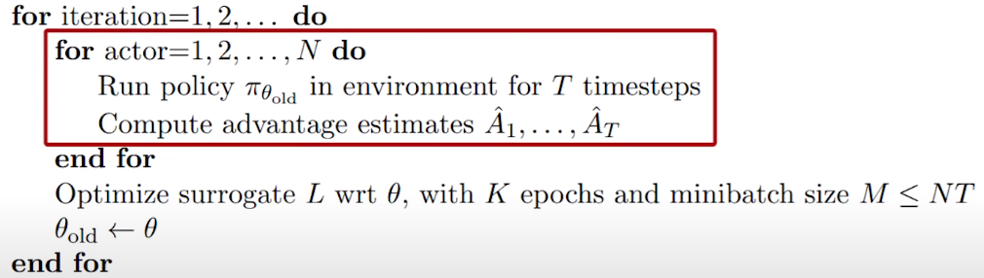
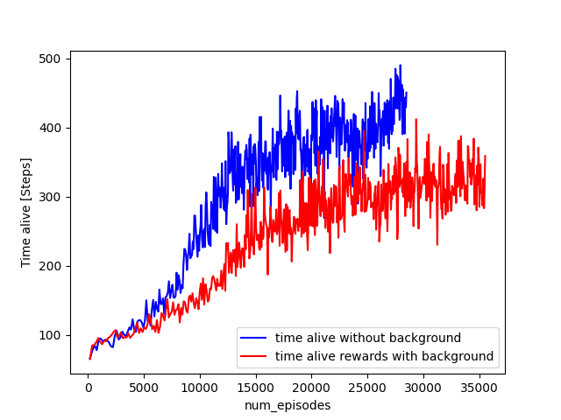
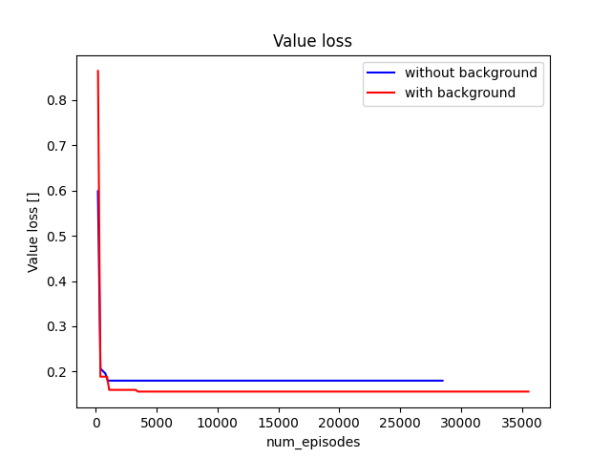
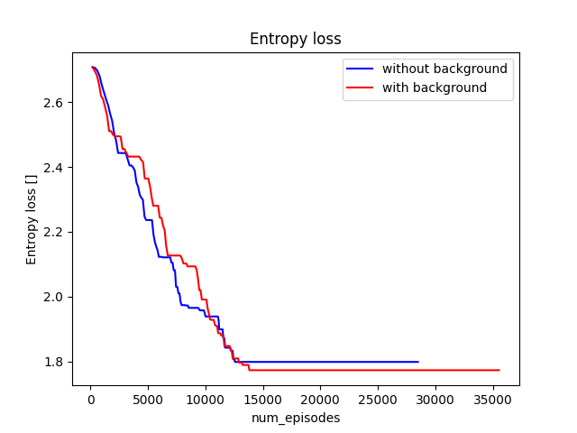

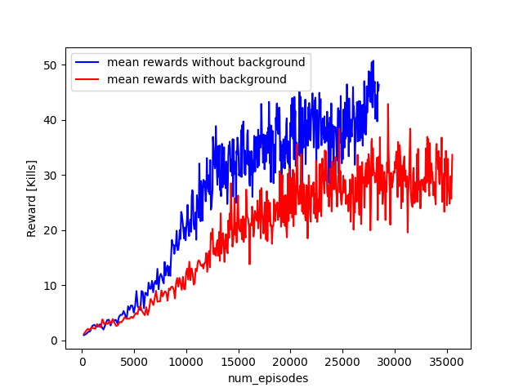
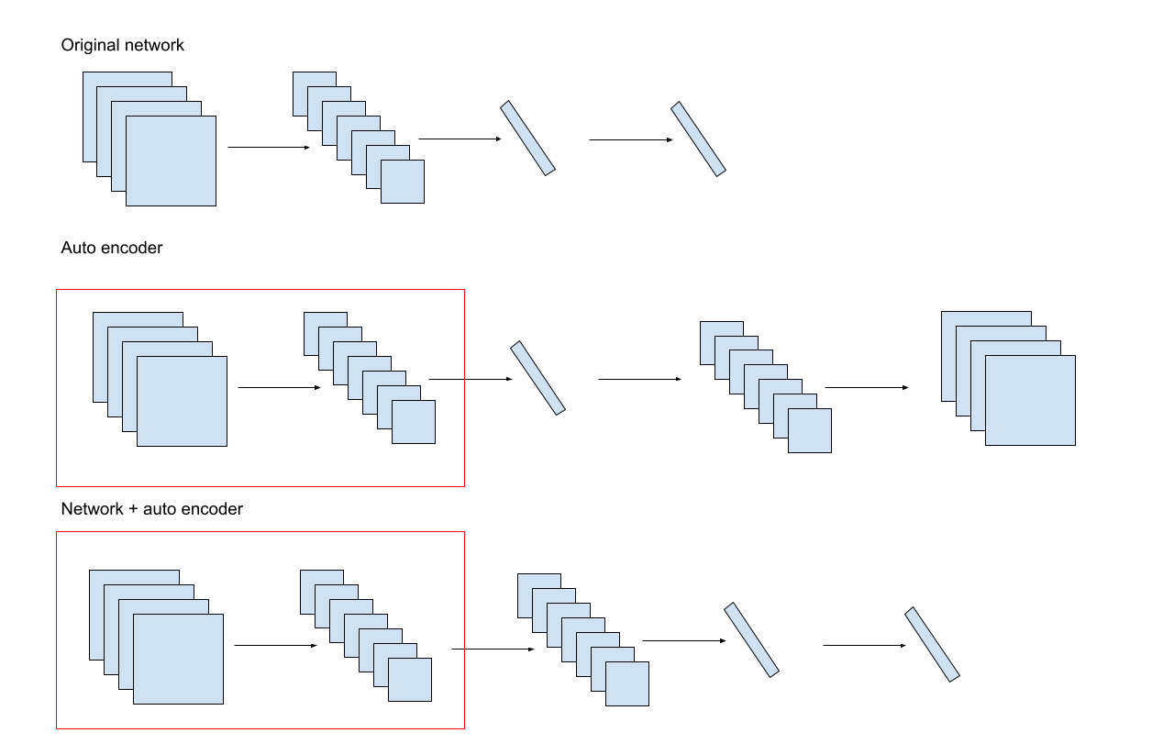
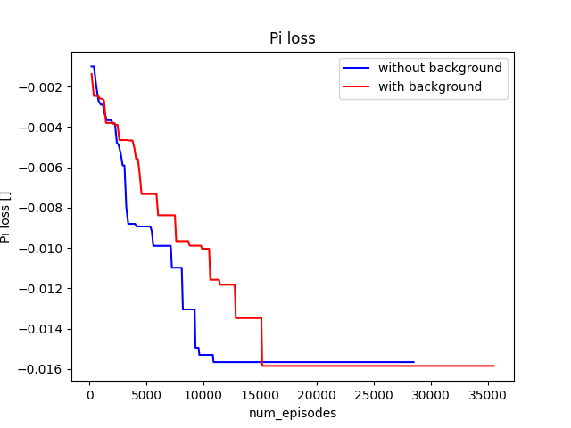

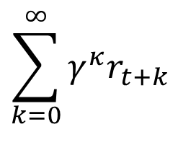

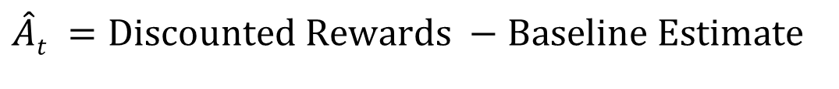
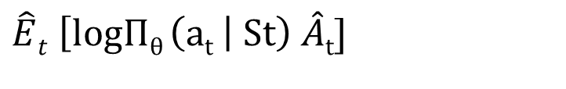
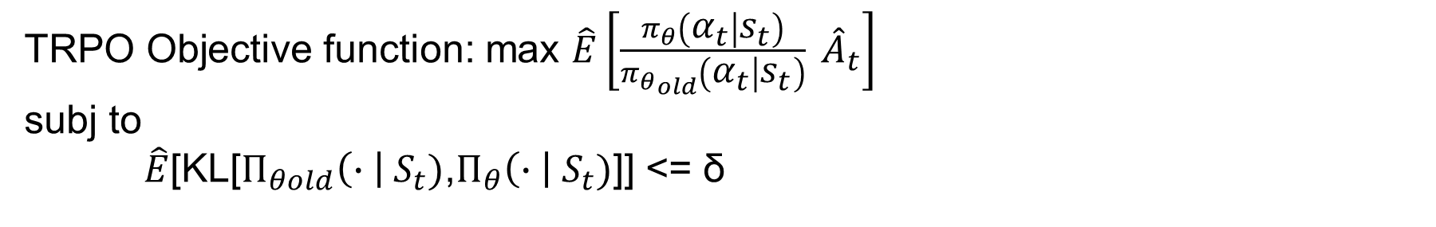
Deep Reinforcement Learning: Generalization in Video Games
Jakob Furbo Enevoldsen, Grigorios Papaspyropoulos, Angelos Daglaroglou DTU, Technical University of Denmark
Implementation in
video games
PPO Computation
Exploration-exploitation
Introduction
Deep Reinforcement Learning is the area of Machine Learning in which Neural Networks are used to solve problems that are too complex to solve either with Supervised or Unsupervised Machine Learning.
Policy Gradient Loss:
$$\hat{E}t \left[logΠθ \left(at \right| St\right) \hat{A}t]$$
Policy is updated by maximizing the PPO-Clip Objective
Advantage Function:
$$\hat{A}t =Discounted Rewards −Baseline Estimate$$
$$\sum_{k=0}^{∞}{γ^{κ}r_{t+k}}$$
Where γ^{t} is the total discounted reward from timestep t
Discounted Rewards ( Return):
Baseline Estimate (Value Function):
Estimate of the discounted sum of rewards from this point onward.
Adam optimizer:
Learning Rate: 1e-3
Epsilon: 1e-8
Beta 1: 0.9
Beta 2 (decay) : 0.999
TRPO Objective function: max $\hat{E}\left[\frac{π_{θ}\left(α_{t} | s_{t}\right)}{{π_{θ}}_{old}\left(α_{t} | s_{t}\right)} {\hat{A}}_{t}\right]$
subj to
$\hat{E}$[KL[$Π_{θold}\left(∙ \right| S_{t})$,$Π_{θ}\left(∙ \right| S_{t})$]] <= δ
Procgen Benchmark consists of 16 unique environments designed to measure both sample efficiency and generalization in reinforcement learning. This benchmark is ideal for evaluating generalization since distinct training and test sets can be generated in each environment.
Clipped Surrogate Objective: Prob ratio r_{t}(θ) = $\frac{π_{θ}\left(α_{t} | s_{t}\right)}{{π_{θ}}_{old}\left(α_{t} | s_{t}\right)}$ , so r(θ_{old}) = 1
a)
b)
c)
Differences of RL with unsuppervised/supervised
Not pre-defined data (not labeled nor unlabelled)
Works in discrete steps
Uses rewards system in every step
Uses trial and error
Uses Exploration/exploitation
Design Principles:
Agent with 0% exploration
Agent with 10% exploration
Agent with 10% exploration and decaying [1]
High Diversity
Fast Evaluation
Tunable Difficulty
Emphasis on Visual Recognition and Motor Control
Main objective function: $$L^{CLIP}\left(θ\right)=\hat{E}t​​[min(r_{t}​\left(θ\right){\hat{A}}_{t}​ , clip\left(r_{t}​\left(θ\right),1−ε,1+ε\right){\hat{A}}_{t}​​)]$$
Algorithm:
Results
Final Loss Function – Final training objective:
L_{t}(θ) =$\hat{E}t$ ${[L_{t}}^{CLIP}\left(θ\right) −C1{L_{t}}^{VF}\left(θ\right)$ + $C2S[Πθ]\left(St\right)$
Next steps
Hyperparameter tuning
TRCP
Auto-encoder
Figure 1: Mean rewards and episode length every aprx. 16000 timesteps
Figure 2: Losses every aprx. 16000 timesteps
References
https://i.makeagif.com/media/1-05-2021/GdzUtG.gif
[1] https://www.manifold.ai/exploration-vs-exploitation-in-reinforcement-learning
[2] https://spinningup.openai.com/en/latest/algorithms/ppo.html
Notes:
1

